Slide 1
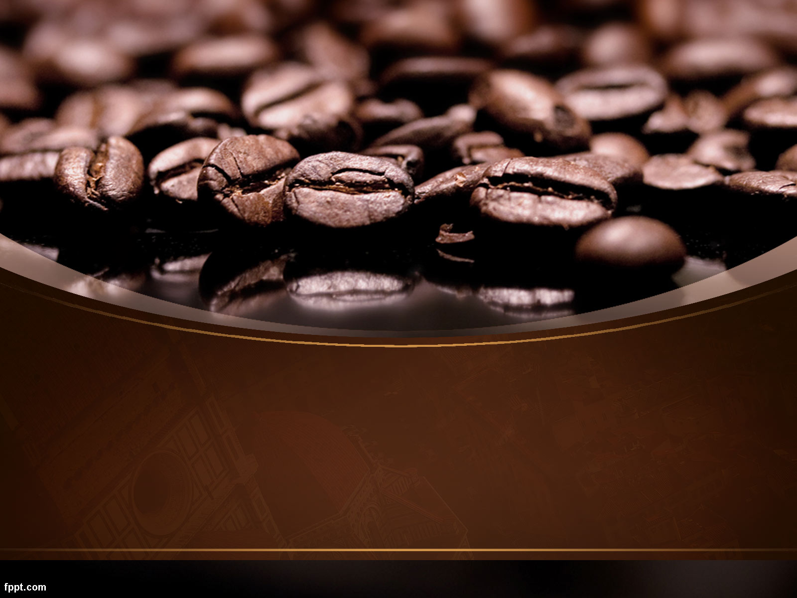

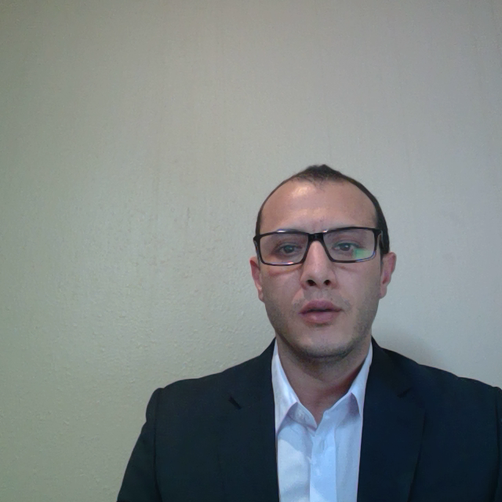
AraBusta Café
Your Second Home

Slide 2
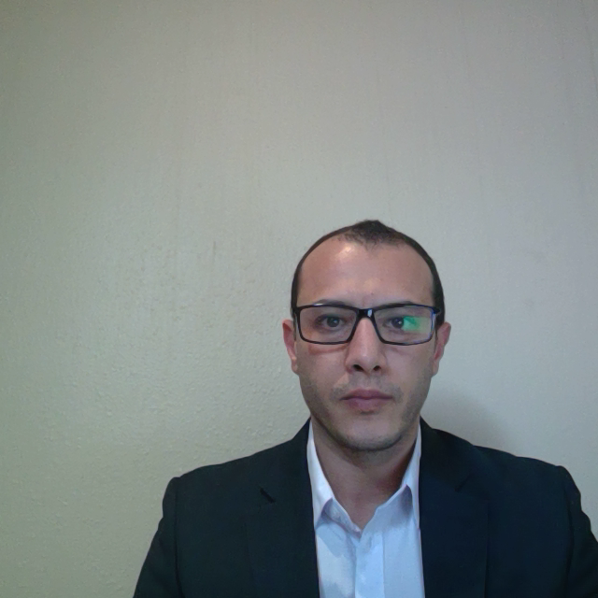
Executive Summery
AraBusta café is determined to become a daily necessity for local coffee addicts.
A Place to start your day from before you go to your work, collage or before starting your day in general.
The Café area will operate a 500 square meter, walking distance from one of the biggest petroleum company.
The location leased for 5 years with an option for extending.
The required EGP 2,550,000 start-up funds.
AraBusta café expecting profit growth by 25% during the same period.

Slide 3

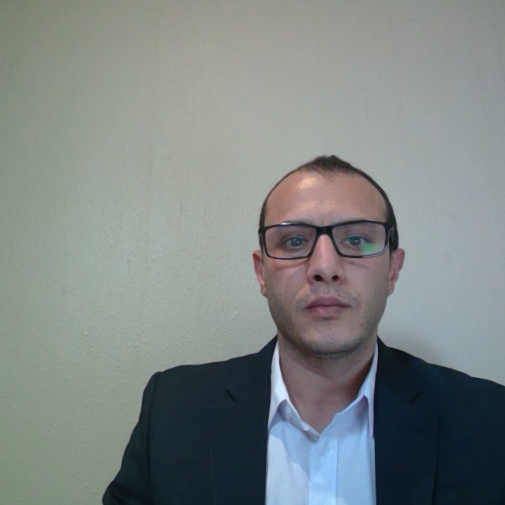
Objectives.
Key of success.
AraBusta Café objectives for the first year of operations are:
AraBusta Café keys of success are:
Employees training on how to prepare the best cup of coffee fast and with customer satisfactions.
Maintain 65% gross margin.
Achieve profits from the first month of operation.
Store location is one of the keys of success, the design is targeting smooth, comfortable, and fast operation.
Become the best coffee shop in terms of quality, speed of service and customer satisfactions in the area.
Marketing strategy is aiming to gain customer loyalty through customer loyalty system, building data base of regular customer.
Coffee quality is one of the key success factors the free Internet.

Slide 4
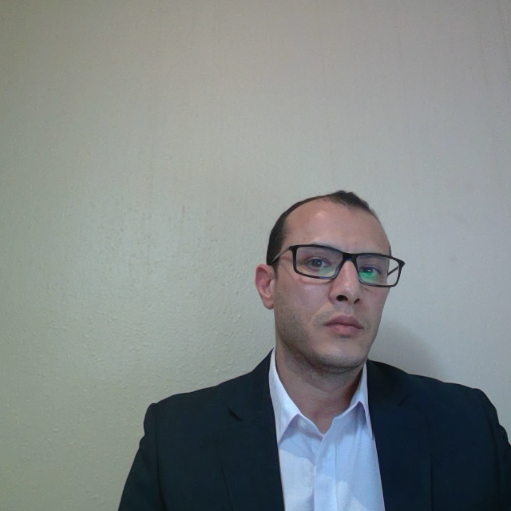
Start-up Requirement Summery
Start-up Requirement Summery
Total Start-Up expenses | EGP 415,200.00
Total Assets | EGP 2,134,800.00
Total Liabilities | EGP 450,000.00
Total Planned Investment | EGP 2,100,000.00
Total Capital | EGP 1,684,800.00
Total Funding | EGP 2,550,000.00

Slide 5
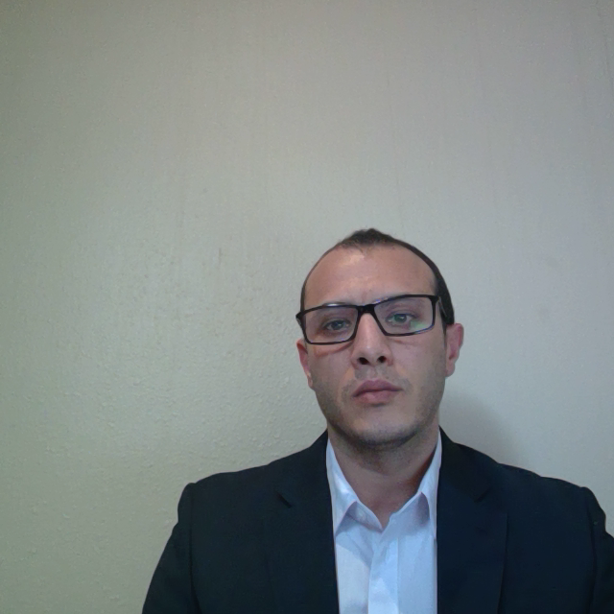
Market Analysis.
AraBusta café classified the customers into 4 classifications as following Gasco Employees 50%, Mall employees 20%, Cinema Visitors 20% and Mall visitors 10%
The annual growth Assumption from Y/ 2021 (33,000 Customers) To Y/ 2023 (35,600 Customers)

Slide 6
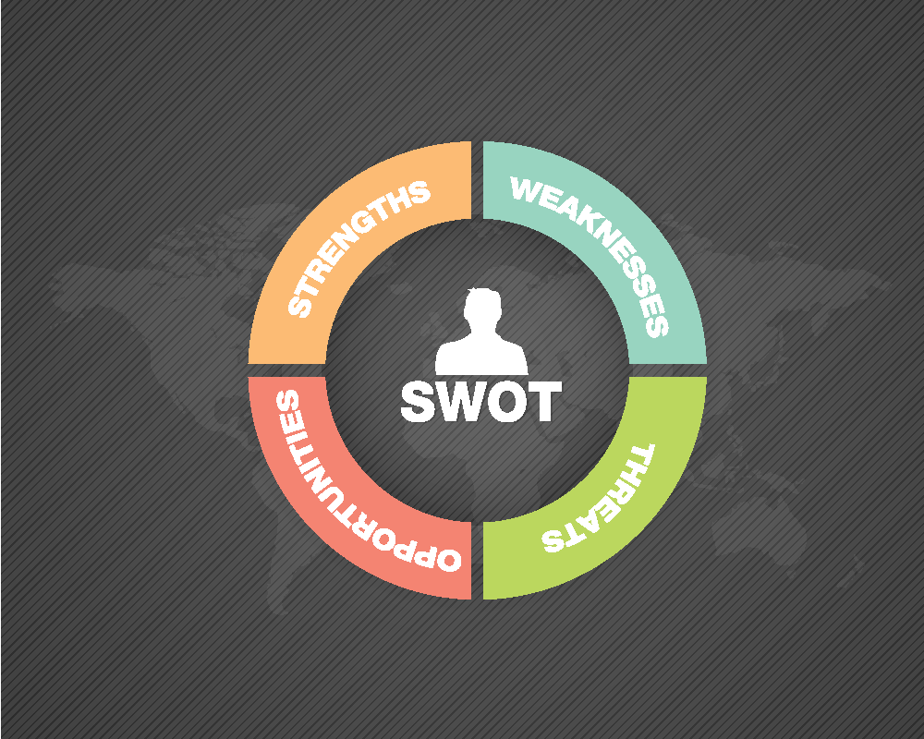
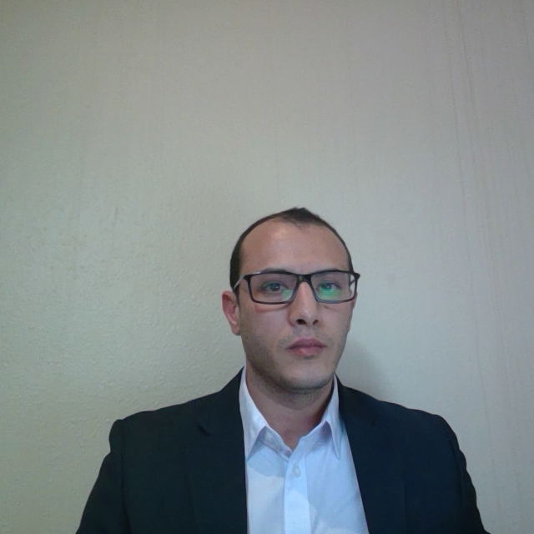
Market Analysis & Sales Literature.
Management Team knowledge.
Coffee location & View
Marketing
Quality.
Service
Convenient setting area.
Well Trained staff with
good experience.
Latest coffee machines.
Menu variety (beverage,
food)
Sales Literature.
4000 flyers will be distributed in the area and will be distributed also through field visit to (Gasco company) and for sure at the furniture mall for all the shops are opening there. All the flyers will be distributed two weeks before the grand opening. We will dedicate free drink from the small size for the first customers at the first hour of our opening.
On the other hands, AraBusta Café will target the customers through different channels and media such as Facebook, Instagram, twitter and Radio channels (Negom FM).
Hight rent rate / month
Cost of facilities (Water, electricity etc…).
Quality of product.
Management team not knowledgeable or customer service oriented.
Locations at petrol stations
No prober setting area
(Drive through).
Small Stalls with low cost.
Rapid deployment at lower cost.

Slide 7
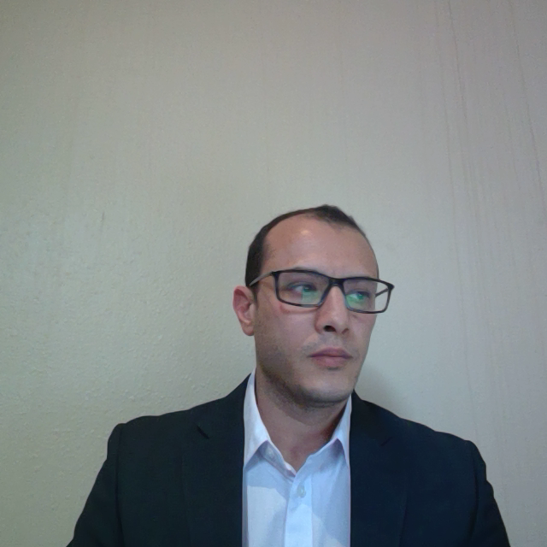
Sales Forecast.
Sales Forecast.
AraBusta Café sales forecasting assumption will have 10% increases in sales in each year from the Y/ 2021 to be EGP 8,760,000.00 till the
Y/ EGP 10,599,600.00.
As well as the direct cost will increase also 10% each year to be in Y/2021 EGP 3,066,000.00 Till Y/ 2023 to be EGP 3,709,860.00
Sales Forecast
Sales | Y/ 2021 | Y/ 2022 | Y/ 2023
Coffee beverages | 5256000 | 5781600 | 6359760
Coffee beans | 1314000 | 1445400 | 1589940
Pastries, etc. | 2190000 | 2409000 | 2649900
Total | EGP 8,760,000.00 | EGP 9,636,000.00 | EGP 10,599,600.00
Direct Cost of Sales | Y/ 2021 | Y/ 2022 | Y/ 2023
Coffee beverages | 1314000 | 1445400 | 1589940
Coffee beans | 657000 | 722700 | 794970
Pastries, etc. | 1095000 | 1204500 | 1324950
Subtotal Direct Cost of Sales | EGP 3,066,000.00 | EGP 3,372,600.00 | EGP 3,709,860.00

Slide 8
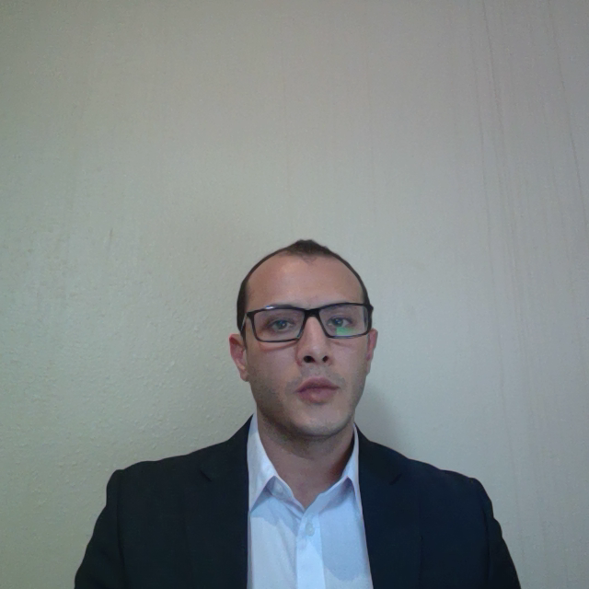
Financial Plan.
Projected cash Flow .
AraBusta Café project cash balance in 2021 will EGP 4,150,870.00 to reach the amount on EGP 10,644,690.00 in 2023
In addition the projected cash balance in Jan 2021 EGP 1132.6 M and will reach to EGP 4150.9 M by Dec 2021
AraBusta Net cash flow in Jan 2021 will be EGP 125,761.00 and will reach to EGP 3,144,025.00 by December 2021.

Slide 9
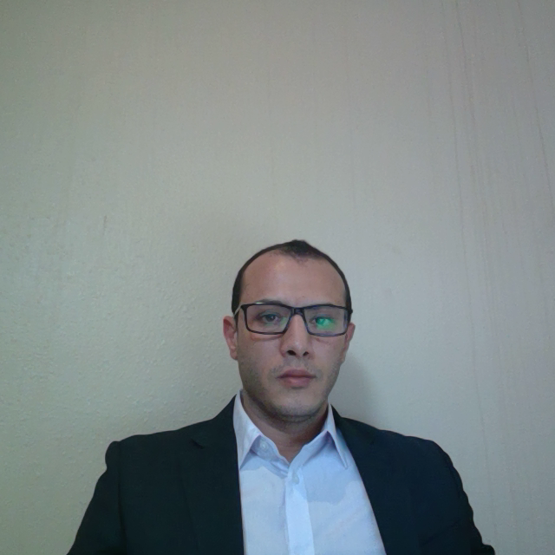
Financial Plan.
Projected Profit and Loss.
AraBusta Café Annual projected sales of EGP 8,760,000 in FY2021 and EGP 10,599,600.00
FY 2023.
Net Profit | EGP 1,294,000.00 | EGP 1,441,456.00 | EGP 1,596,029.52
Net Profit / Sales | 14.77% | 14.96% | 15.06%

Slide 10
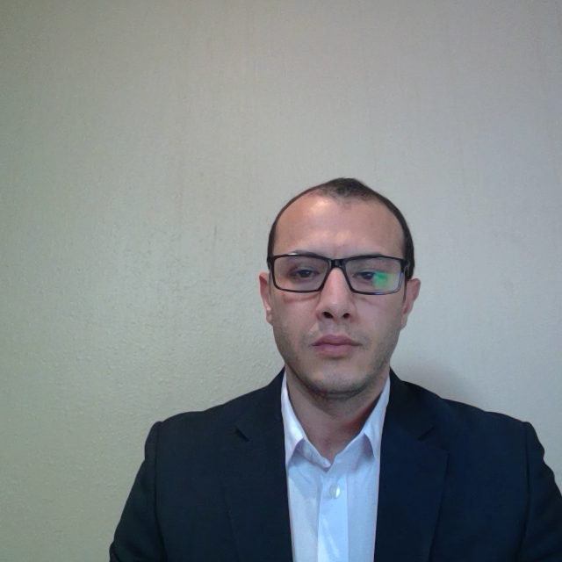
Financial Plan.
Projected Break- Even.
With average monthly fixed costs of EGP 111 K in Y/ 2021 and an average margin of 65%, AraBusta Café break-even sales volume which is the point of no profit no lose is around EGP 220 K As shown further, the company is expected to generate such sales volume from the out start and the Breakeven per unit 2500 unit.

Slide 11
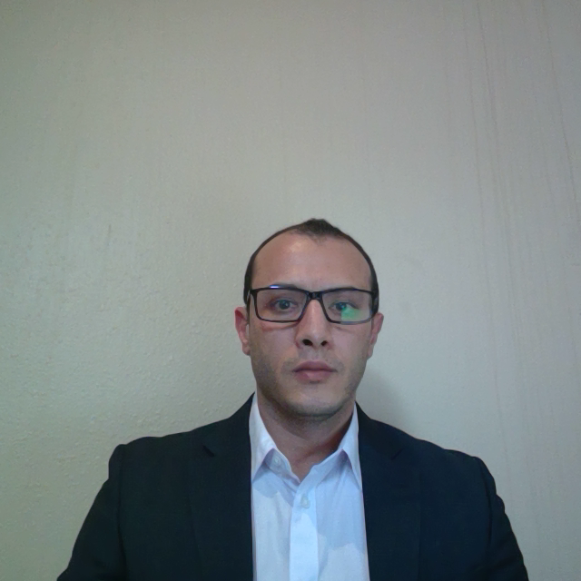
Financial Plan.
Projected Balance Sheet.
The company's net worth is expected to increase from approximately EGP 2,978,800.00
by the end of FY2021to approximately EGP 3,280,829.52 in FY2023

Slide 12
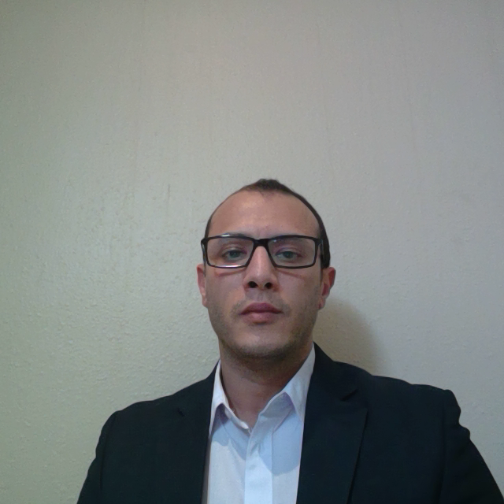
Thank you
AraBusta Café
Your Second Home

